Slide 1
Unit 6

Slide 2
Shading model – technique that defines when and where do we calculate the components needed for light calculations.

Slide 3
In computer graphics, shading refers to the process of altering the color of an object/surface/polygon in the 3D scene, based on things like the surface's angle to lights, its distance from lights, its angle to the camera and material properties

Slide 4
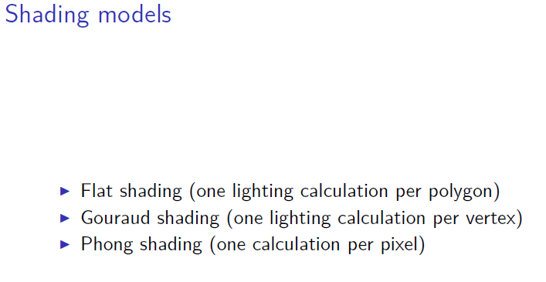

Slide 5
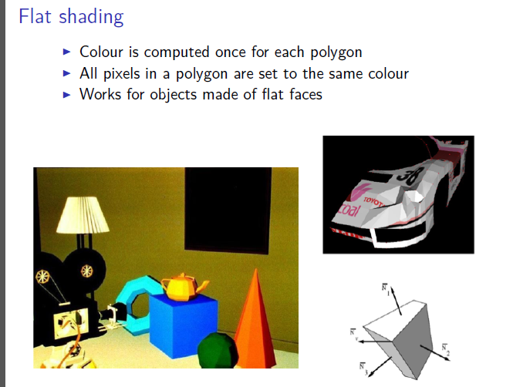

Slide 6
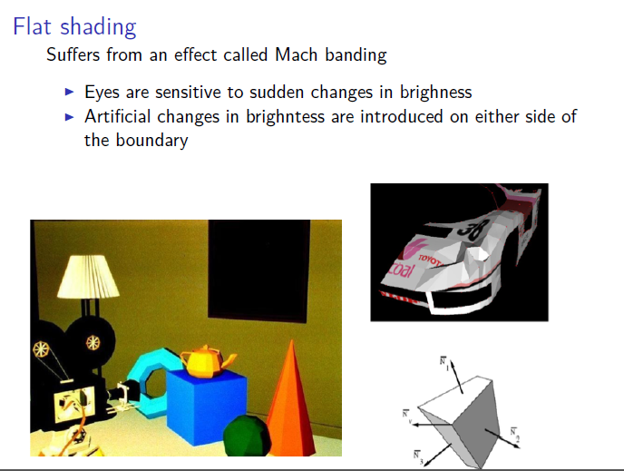

Slide 7
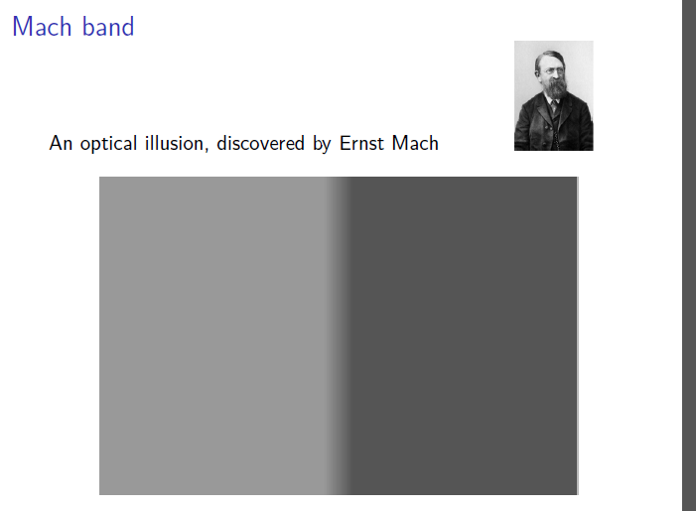

Slide 8
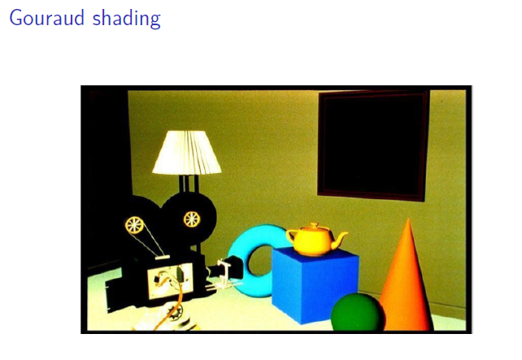

Slide 9
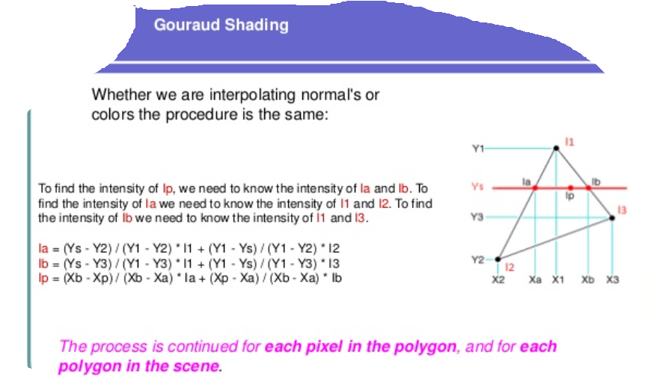

Slide 10
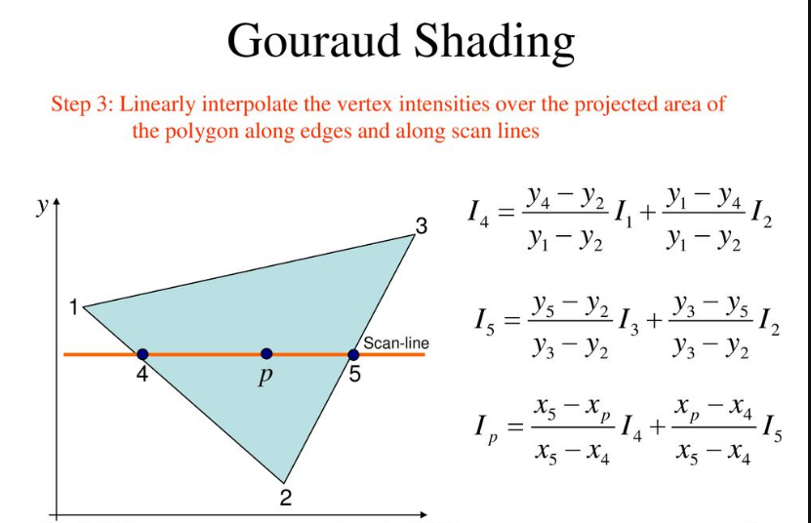

Slide 11
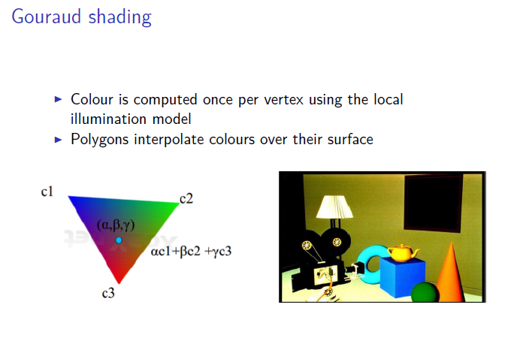

Slide 12
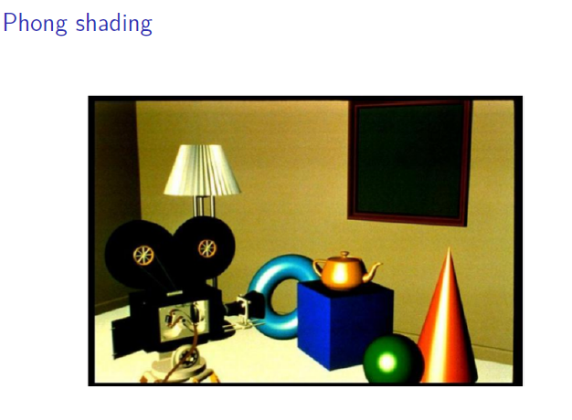

Slide 13
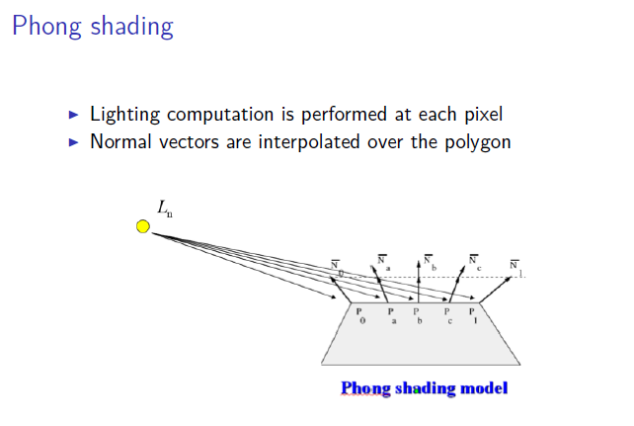

Slide 14
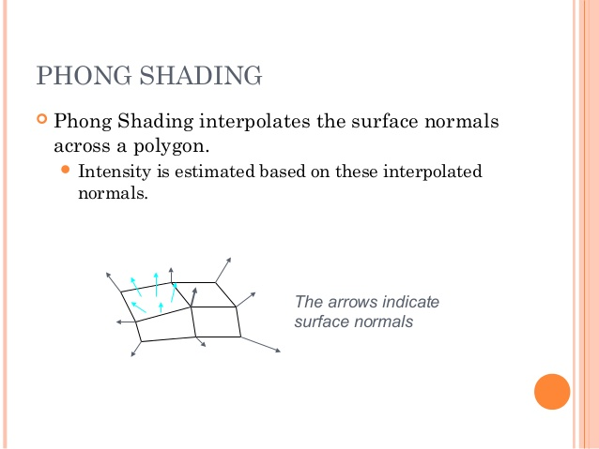

Slide 15
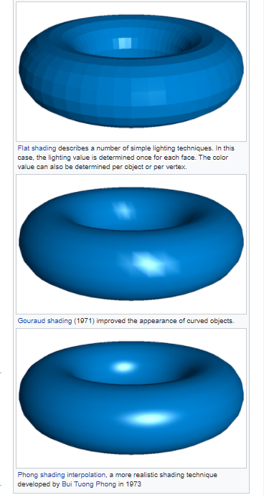

Slide 16
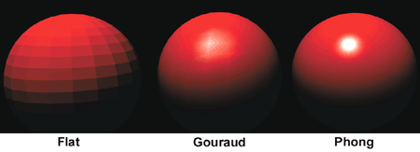

Slide 17
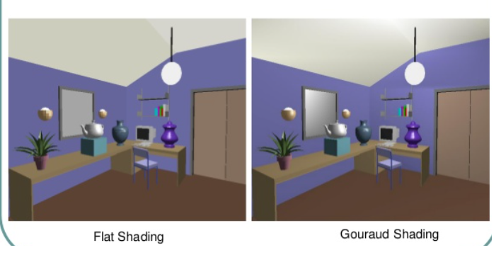

Slide 18
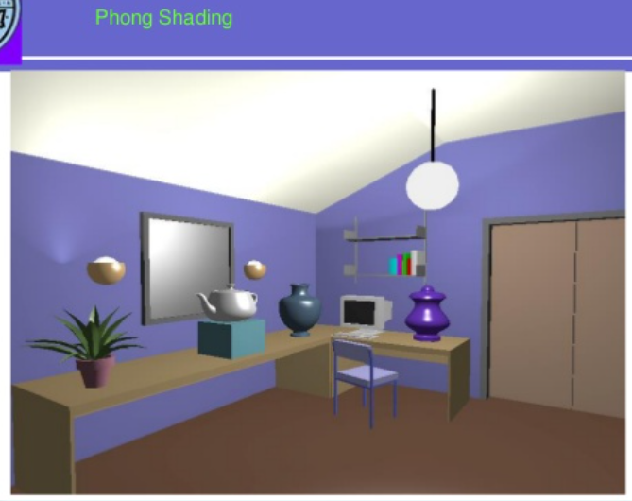

Slide 19
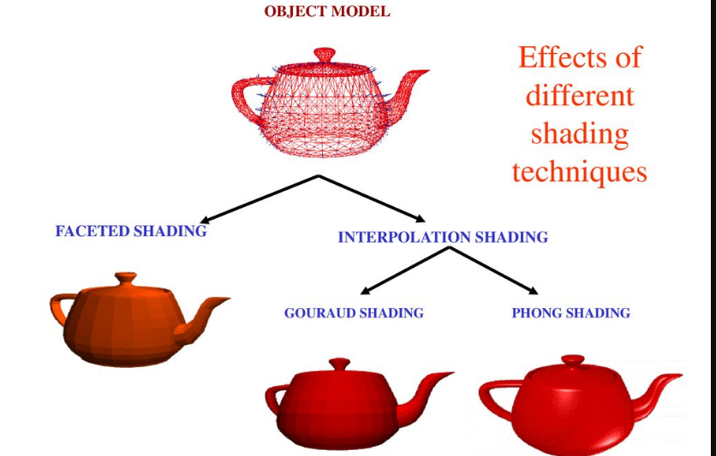

Slide 20
flat shading link
https://youtu.be/YYpUSgT_uYk

Slide 21
https://youtu.be/mcHwpjcxvzs
https://youtu.be/jr-PoIsqM7g

Slide 22
Shading techniques link
https://www.slideshare.net/nidhalelabbadi/advanced-computer-graphics-shading

